Slide 1

Detection of Pneumonia in Chest X-Ray Images
Under the Guidance of
Ms P. Sree Lakshmi
Assistant Professor
Team-13:
12WH1A1217 – D.N.V.Kiranmai
16WH1A1220 – G. Arun Jyothi
16WH1A1243 – M. Poojitha

Slide 2
Contents
Introduction
Problem Definition
Literature Survey
Existing System
Proposed System
Architecture Diagram
Dataset
Models and Evaluation
Testing
Deployment of Model
Plan of Action
References

Slide 3
Introduction
Pneumonia is a disease which occurs in lungs caused by a bacterial infection.
Early diagnosis is an important factor for successful treatment.
Chest X-ray images are best-known common clinical method for diagnosing of pneumonia.

Slide 4
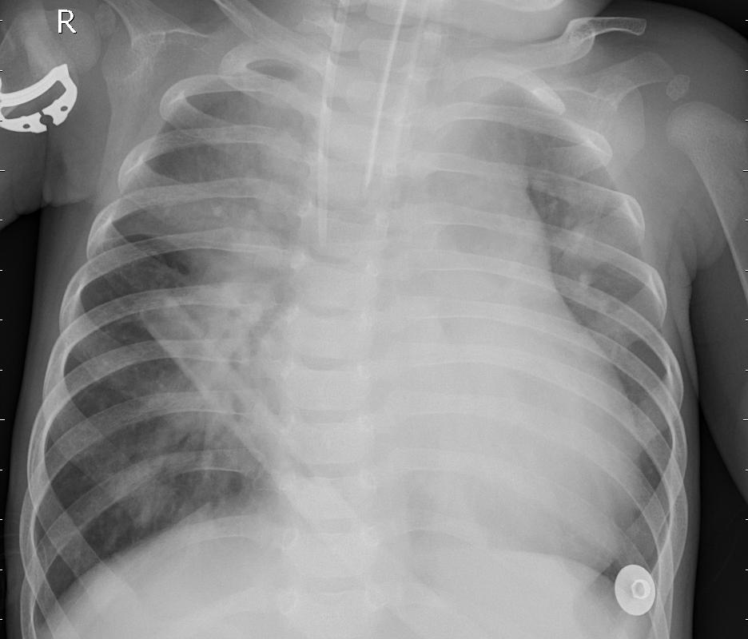
Problem Definition
Detecting whether a patient is infected
with pneumonia or not from Chest
X-Ray Images using Deep Learning
Input:
Normal X-Ray or
Pneumonia X-Ray
Output:

Slide 5
Literature Survey
Antin et al. used a DenseNet-121 layer with utilizing transfer learning method and they achieved 0.60 % area under the curve (AUC) value.
Rajpurkar, et al. proposed a 121-layer convolutional neural network based on DenseNet and named as CheXNet .

Slide 6
Existing System
Radiologists diagnose pneumonia from chest X-ray images.
Appearance of pneumonia in X-ray images is often unclear.
It can be confused with other diseases.

Slide 7
Proposed System
An automated detection system is proposed for the diagnosis of pneumonia with chest x-ray images.
The system is developed using Convolutional Neural Networks.
Computerized support systems help radiologists.

Slide 8
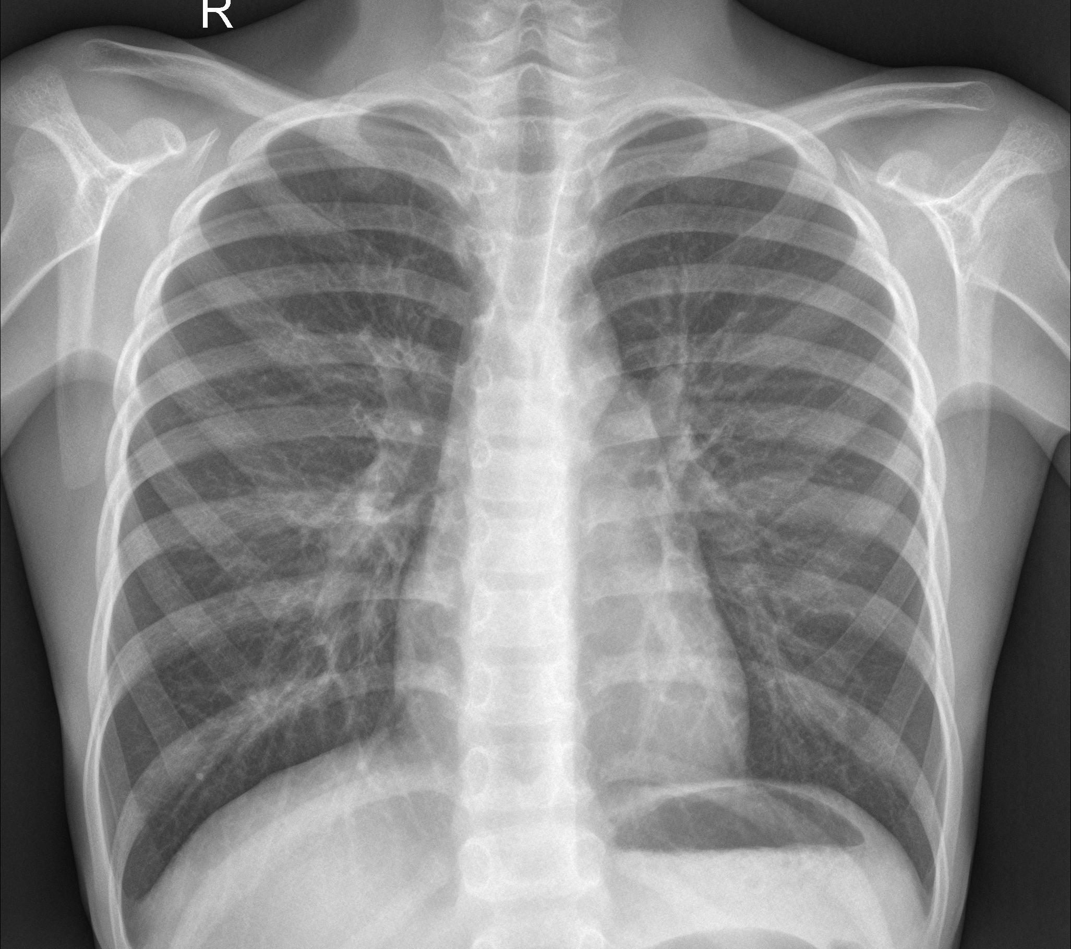
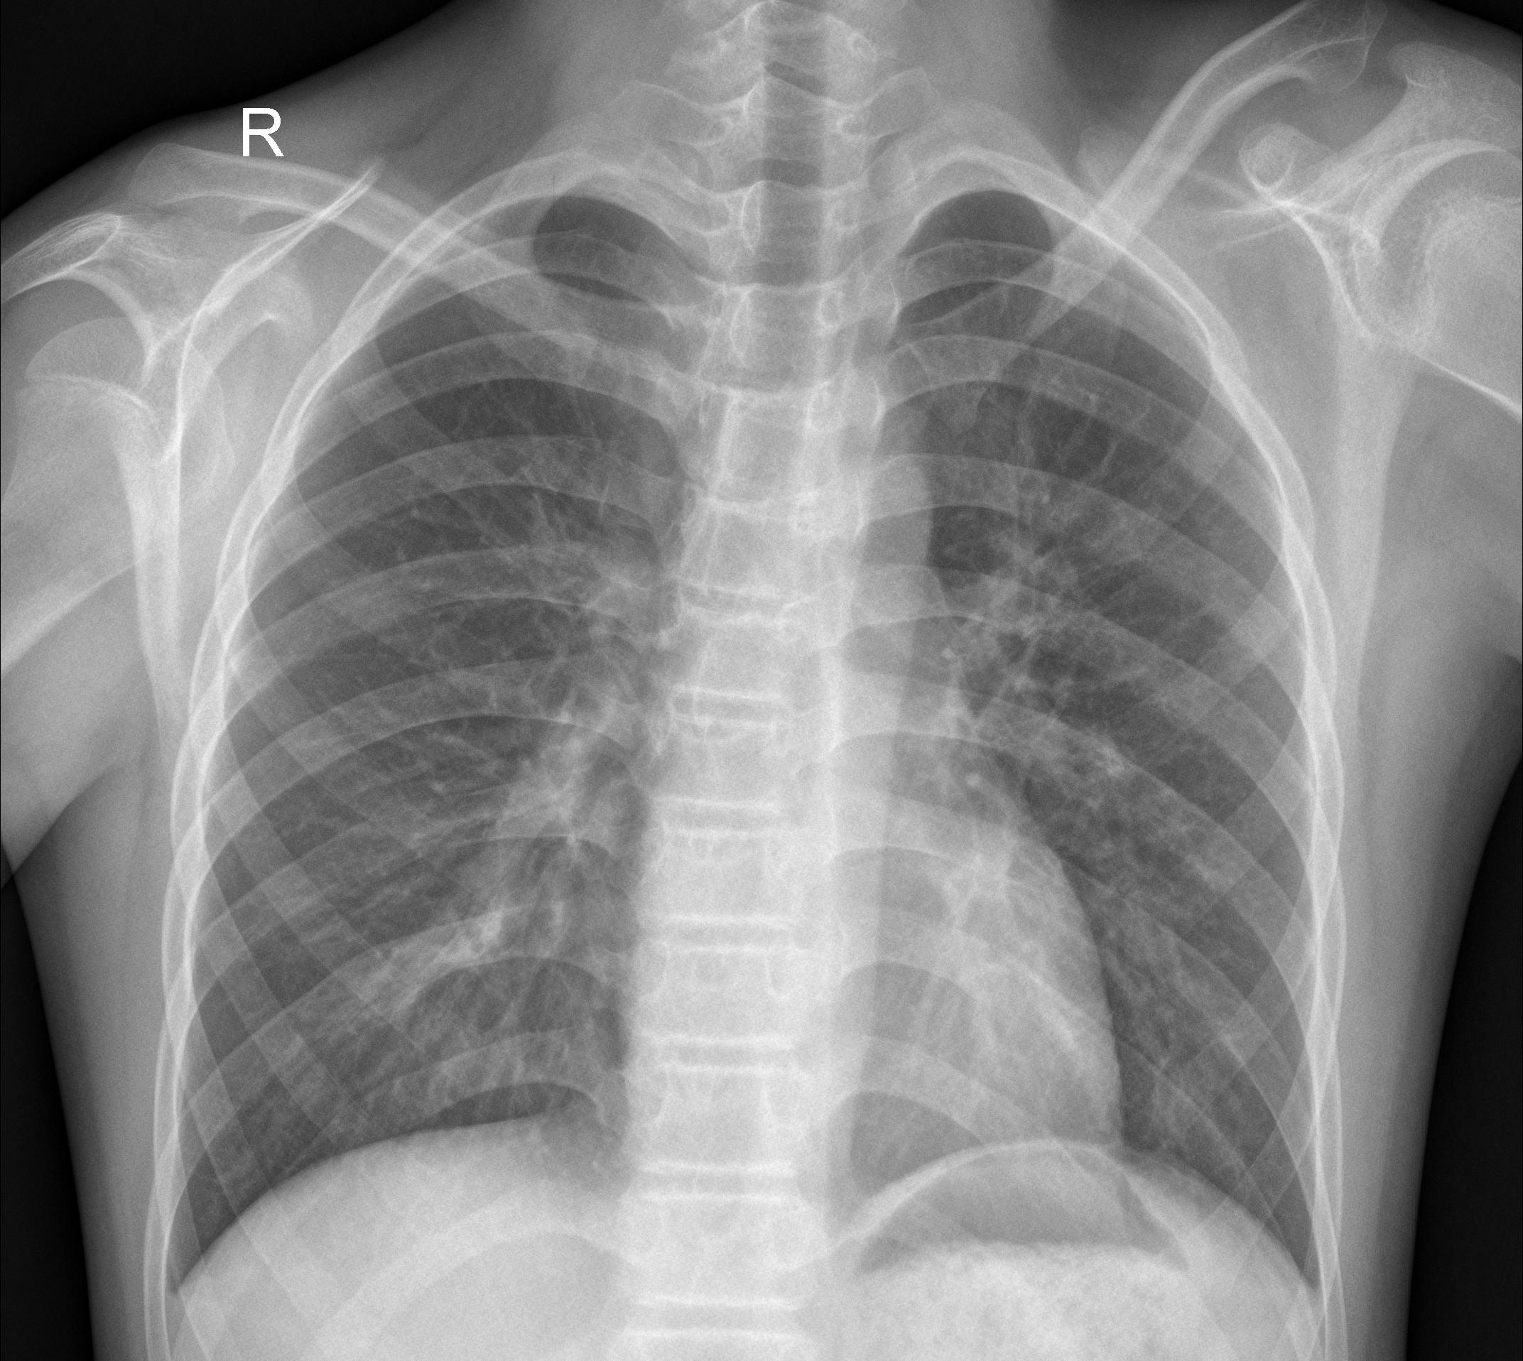
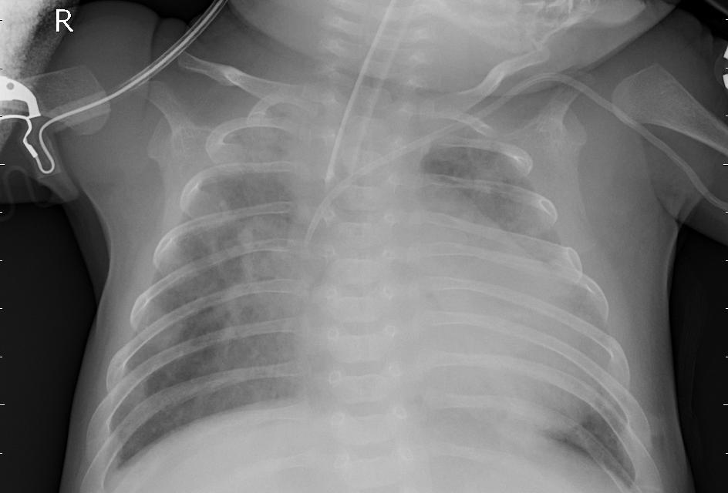
Dataset
5856 frontal chest X-ray Images
1583 normal case, 4273 pneumonia case images
Resolutions - 712x439 to 2338x2025
Normal cases
Pneumonia cases
Data Samples

Slide 9
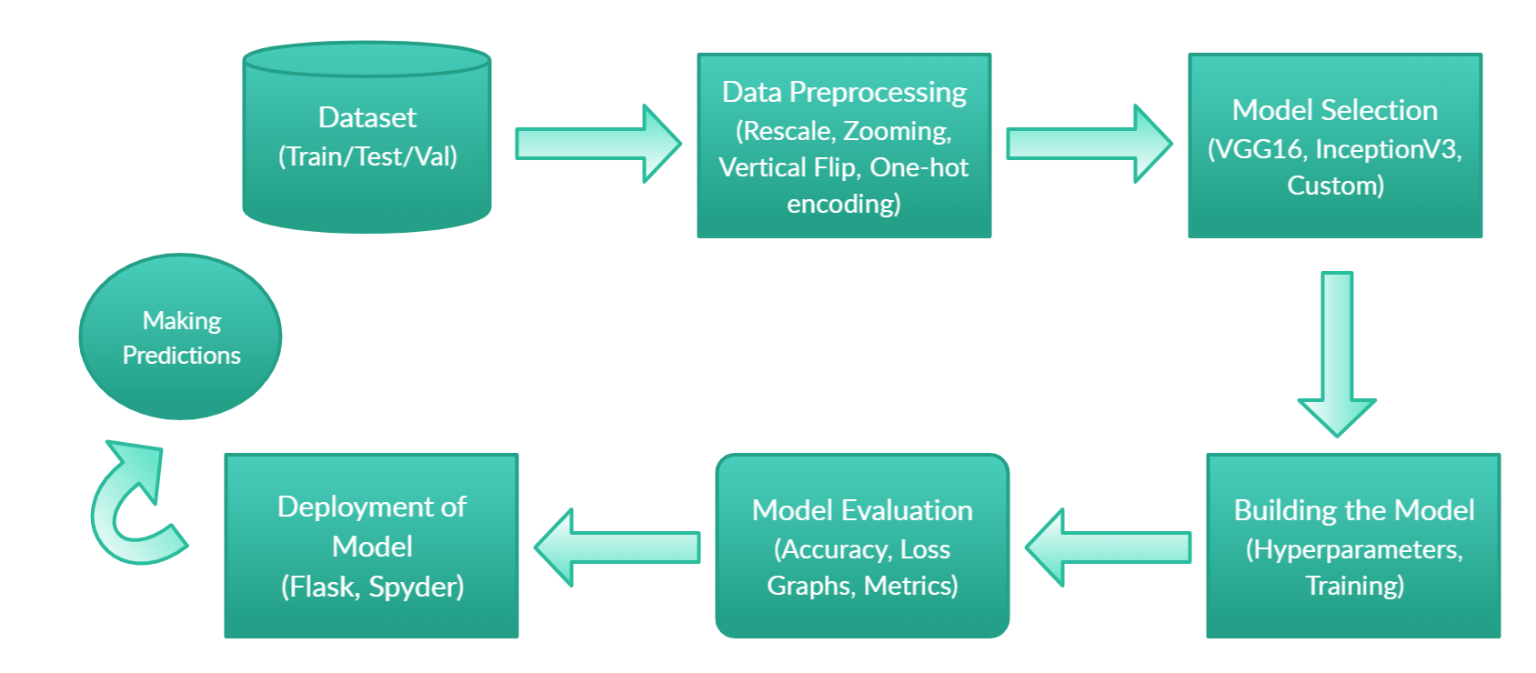
Architecture Diagram

Slide 10
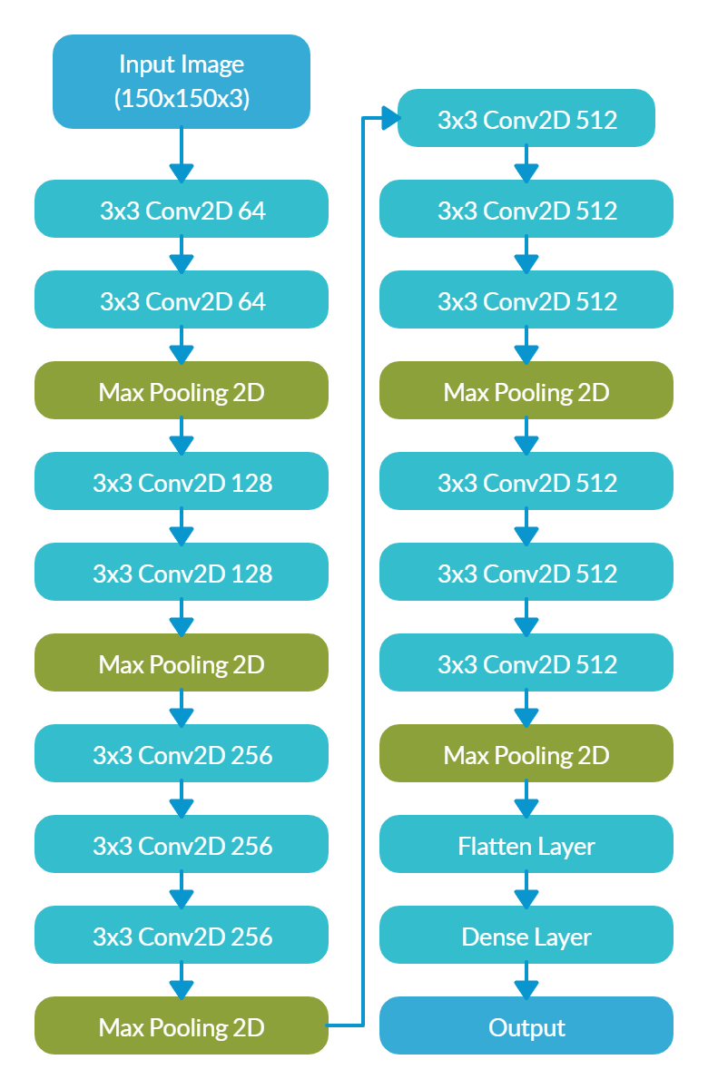
VGG16 MODEL
Convolution layers of 3x3 filter with a stride 1
Maxpool layer of 2x2 filter of stride 2
RMSprop Optimizer
Softmax Activation Function
30 Epochs

Slide 11
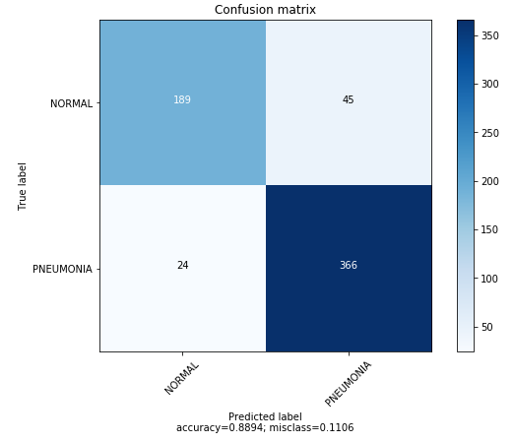
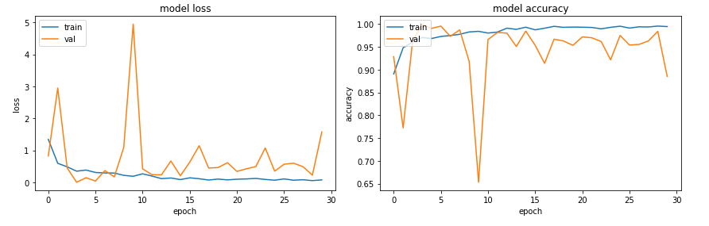
EVALUATION
TEST METRICS
Accuracy: 88.9423076923077%
Precision: 89.05109489051095%
Recall: 93.84615384615384%
F1-score: 91.38576779026218%
TRAIN METRICS
Accuracy: 93.93417527745886 %
Loss: 7.712412509147498 %

Slide 12
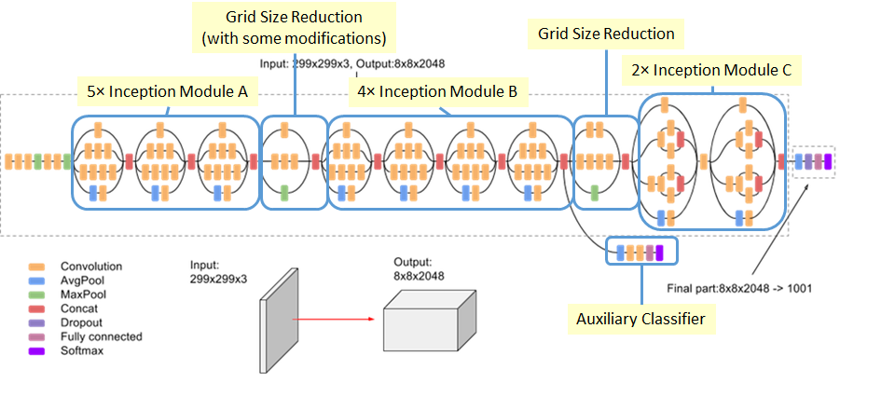
INCEPTIONV3 MODEL
Adam Optimizer
Sigmoid Function
Dropout rate (0.33)
Batch Normalization
Increases depth and width of deep learning network
30 Epochs

Slide 13
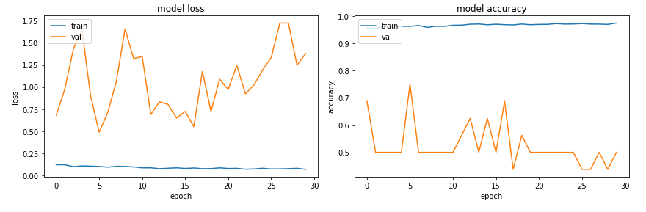
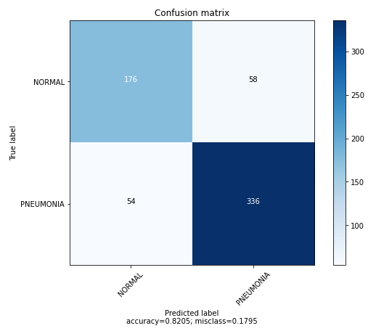
EVALUATION
TEST METRICS
Accuracy: 82.05128205128204%
Precision: 85.27918781725889%
Recall: 86.15384615384616%
F1-score: 85.71428571428572%
TRAIN METRICS
Accuracy: 97.53971%
Loss: 6.87396%

Slide 14
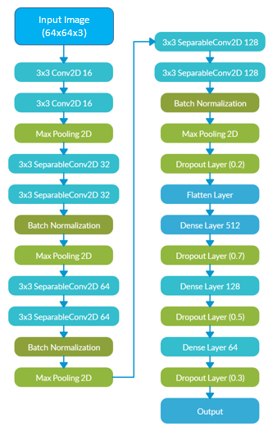
CUSTOM MODEL
Convolution layers of 3x3 filter with a stride 2
Maxpool layer of 2x2 filter of stride 2
RELU, Sigmoid Activation Function
Adam optimizer
35 Epochs

Slide 15
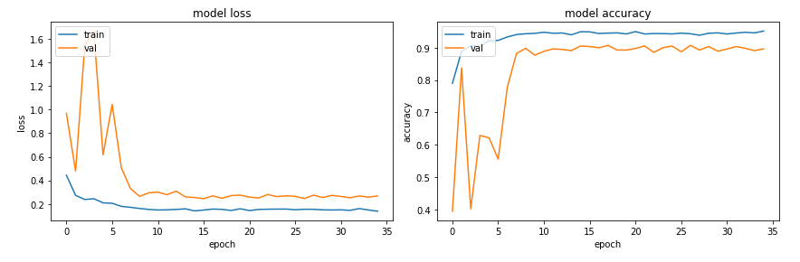
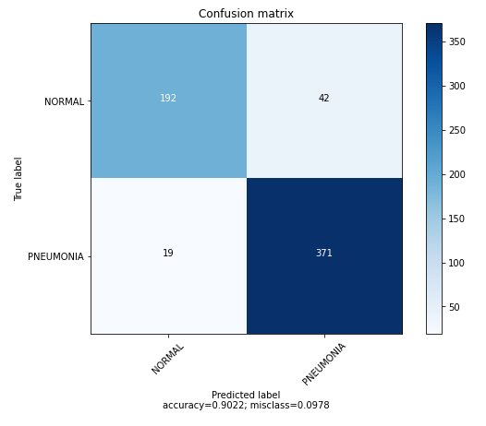
EVALUATION
TEST METRICS
Accuracy: 90.22435897435898%
Precision: 89.83050847457628%
Recall: 95.12820512820512%
F1-score: 92.40348692403487%
TRAIN METRICS
Accuracy: 95.15564%
Loss: 13.82808%

Slide 16
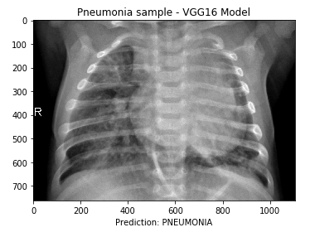
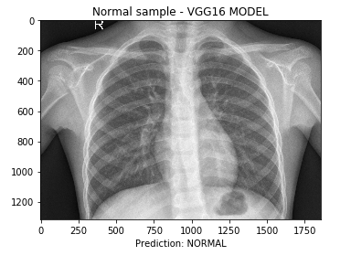
Testing
VGG16 MODEL SAMPLE PREDICTIONS

Slide 17
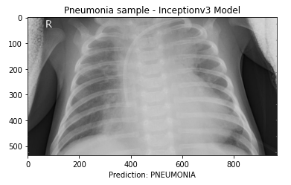
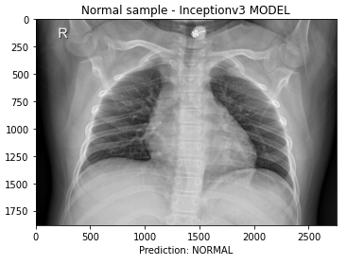
Testing
INCEPTIONV3 MODEL SAMPLE PREDICTIONS

Slide 18
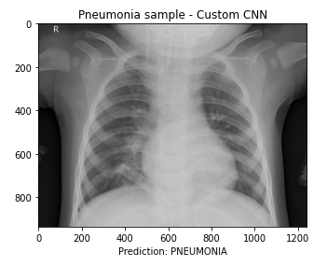
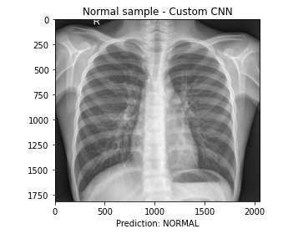
Testing
CUSTOM CNN SAMPLE PREDICTIONS

Slide 19
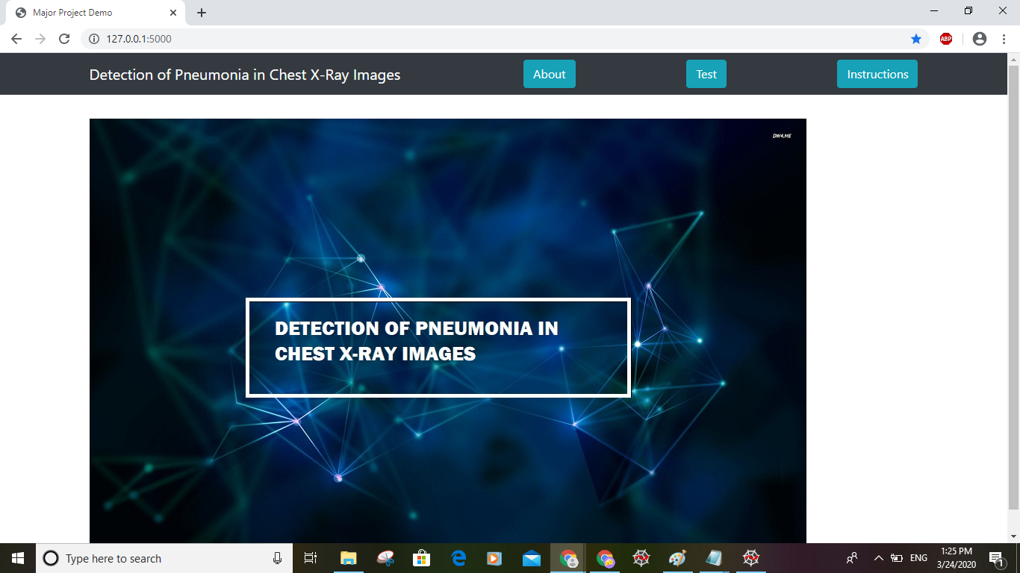
Deployment of Model

Slide 20
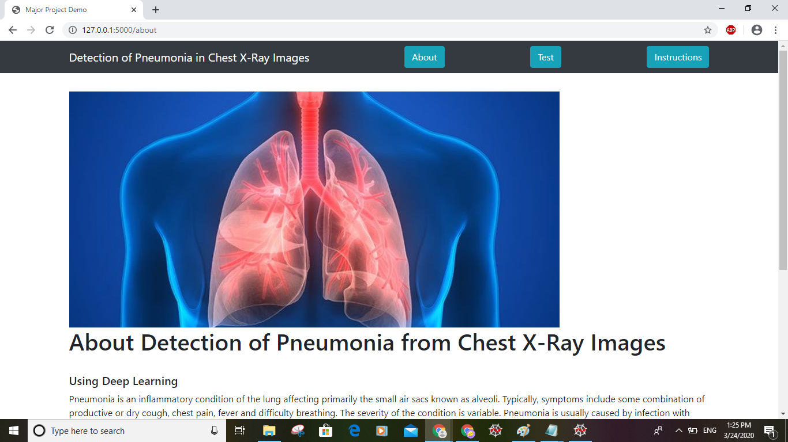
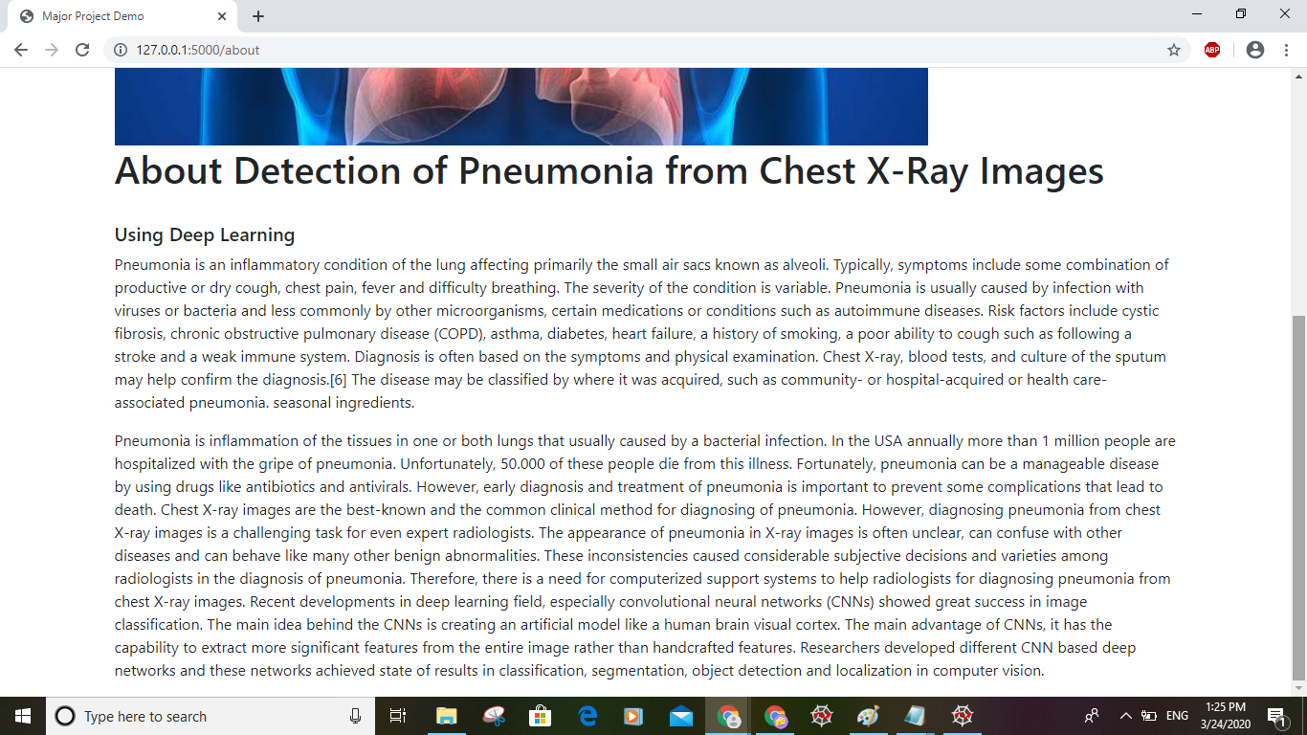
Deployment of Model

Slide 21
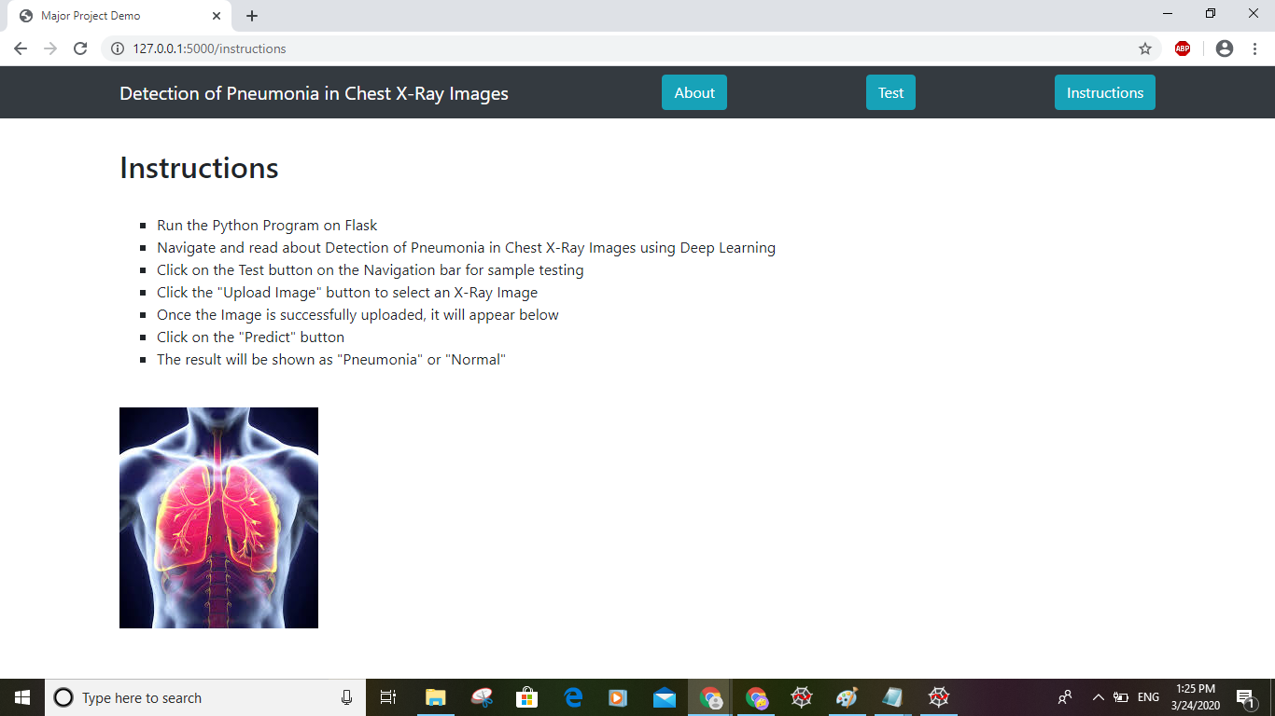
Deployment of Model

Slide 22
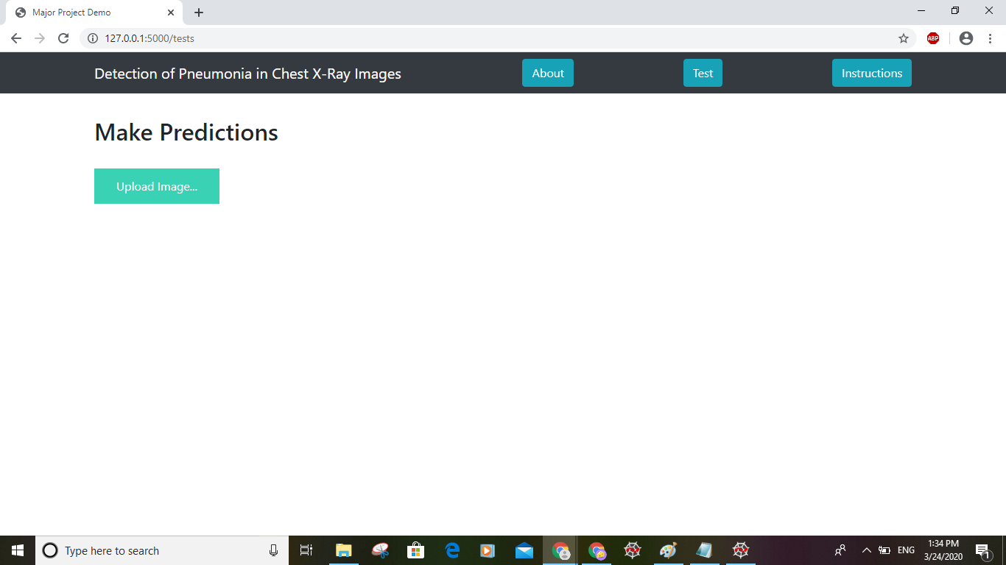
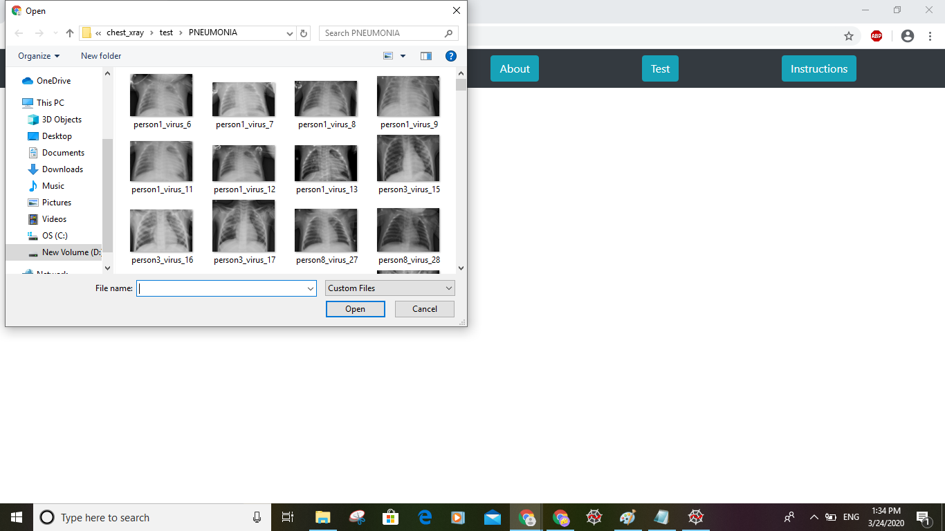
Deployment of Model

Slide 23
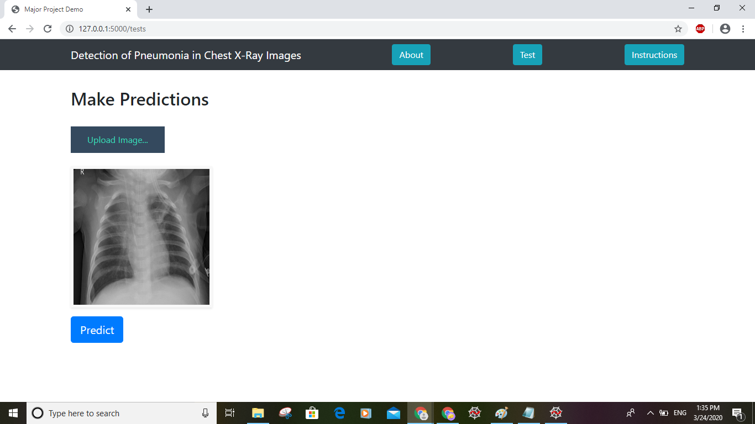
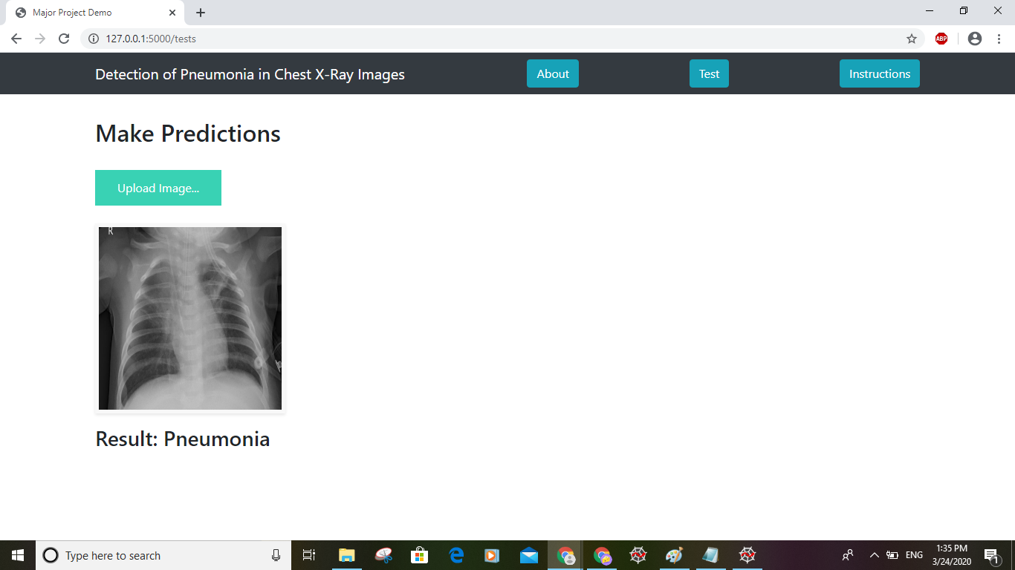
Deployment of Model

Slide 24
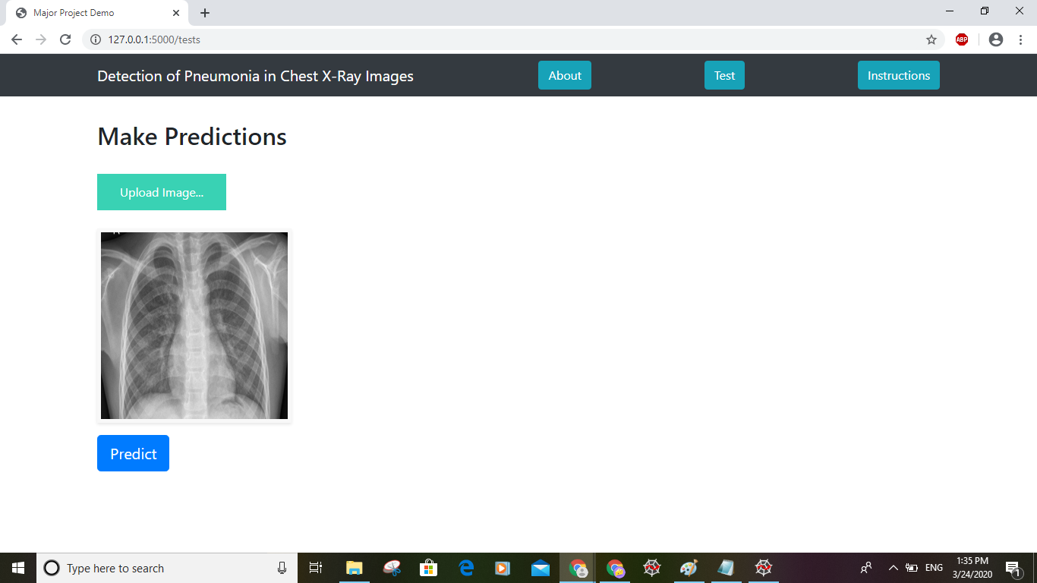
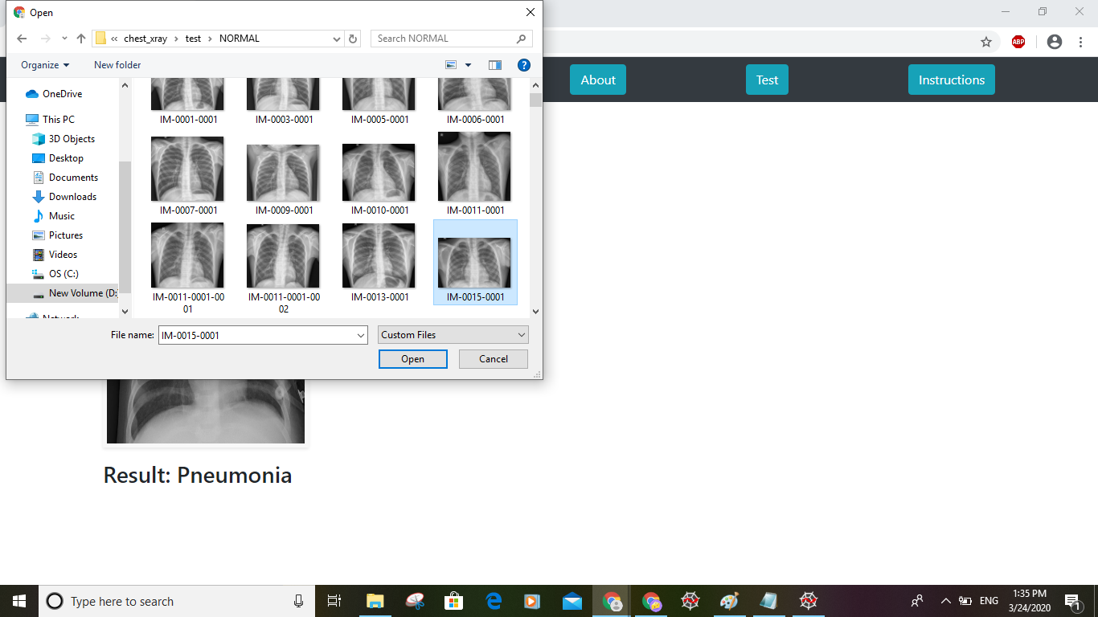
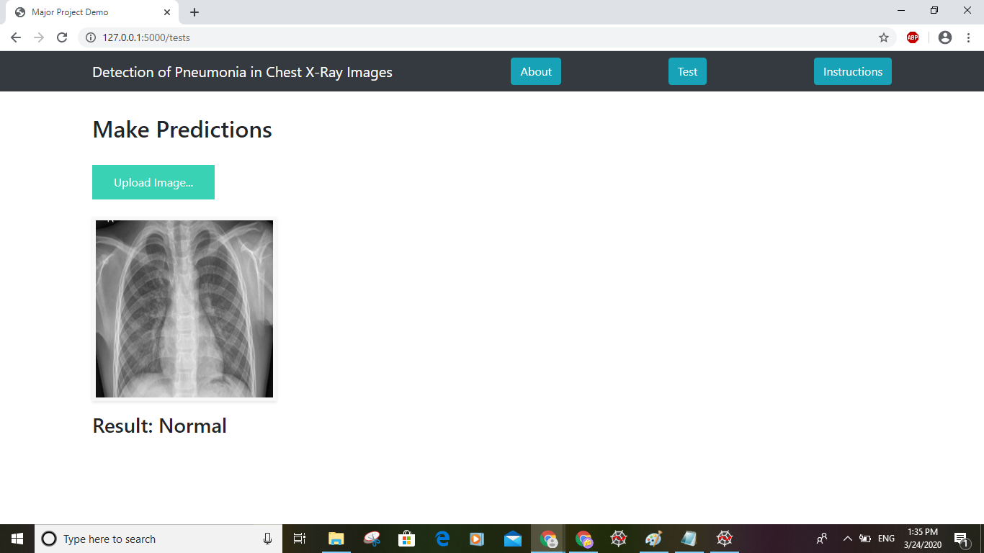
Deployment of Model

Slide 25
Action Plan
Module Information | Status | Time required to Complete
Literature Survey | Completed | 1 Week
Requirement Analysis | Completed | 1 Week
Design | Completed | 2 Weeks
Implementation | Completed | 4 Weeks
Documentation | Completed | 2 Weeks
Final Submission | Completed

Slide 26
References
[1] Enes AYAN and Halil Murat ÜNVER, Diagnosis of Pneumonia from Chest X-Ray Images using Deep Learning,
IEEE Scientific Meeting on Electrical-Electronics & Biomedical Engineering and Computer Science, Vol. ,
pp.27 – 34, 2019.
[2] Aarti Bagul, Pranav Rajpurkar, et al., CheXNet: Radiologist-Level Pneumonia Detection on Chest X-Rays with
Deep Learning, arXiv:1711.05225v3 [cs.CV], December 25, 2017.
[3] Arata Saraiva, Jose Vigno Moura Sousa, Luciano Lopes de Sousa, and N. M. Fonseca Ferreira, Classification of
Images of Childhood Pneumonia using Convolutional Neural Networks, ReasearchGate, January, 2019.
[4] Mangal Sain, Okeke Stephen and Uchenna Joseph, An Efficient Deep Learning Approach to Pneumonia
Classification in Healthcare, Journal of Healthcare Engineering, Vol. 2019, March 27, 2019.
[5] Aditya Khamparia, Sanjay Kumar Singh, Victor Hugo C. de Albuquerque and Vikash Chouhan, An Efficient
Deep Learning Approach to Pneumonia Classification in Healthcare, Molecular Diversity Preservation
International and Multidisciplinary Digital Publishing Institute (MDPI) Journals, Vol.10, Issue 2,
January 12, 2020.

Slide 27
THANK YOU

